Slide 1
MEDB 5510 Clinical Research Methods
Week 1
Introduction to Clinical Research Methods

Slide 2
Clinical Research Introduction
What is clinical research
Structured process
Investigate facts & theories, explore connections
Examine clinical conditions and outcomes
How is clinical research used?
Drug development
Evaluation of best practices
Health care quality assessment
Public policy
2

Slide 3
Clinical Research Introduction
Dichotomies describing research
Theoretical vs Applied
Laboratory vs Field
Participant Report vs Researcher Observation
Quantitative vs Qualitative
Positivist vs Constructivist (theoretical framework)
Objective vs Subjective (data collection methods)
Statistical vs Descriptive (data analysis)
Mixed methods
3
Notes:
[

Slide 4
Clinical Research Introduction
4
Notes:
[

Slide 5
Clinical Research Introduction
The research process
Identify the research question
Design the study
Conduct the study
Analyze the data
Communicate the results
Importance of dissemination
5
Notes:
[

Slide 6
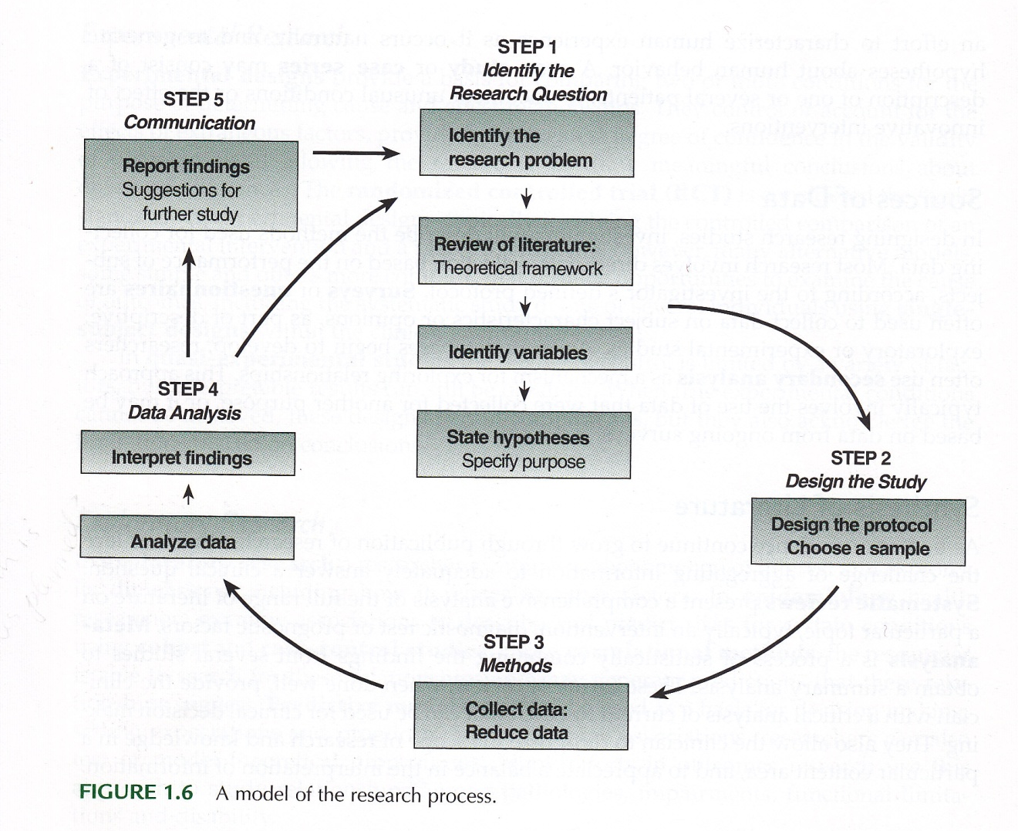
Clinical Research Introduction
Portney & Watkins (2009)
6
Notes:
[

Slide 7
Clinical Research Introduction
7
The role of theory in research
Summarize
Explain
Predict
Development of new knowledge

Slide 8
Clinical Research Introduction
8
Characteristics of a theory
Economical
Important
Acceptance can change

Slide 9
Clinical Research Introduction
9
The structure of a theory
“Process” of a theory
Inductive – Theory development (specific ➔ general)
Deductive – Theory testing (general ➔ specific)

Slide 10
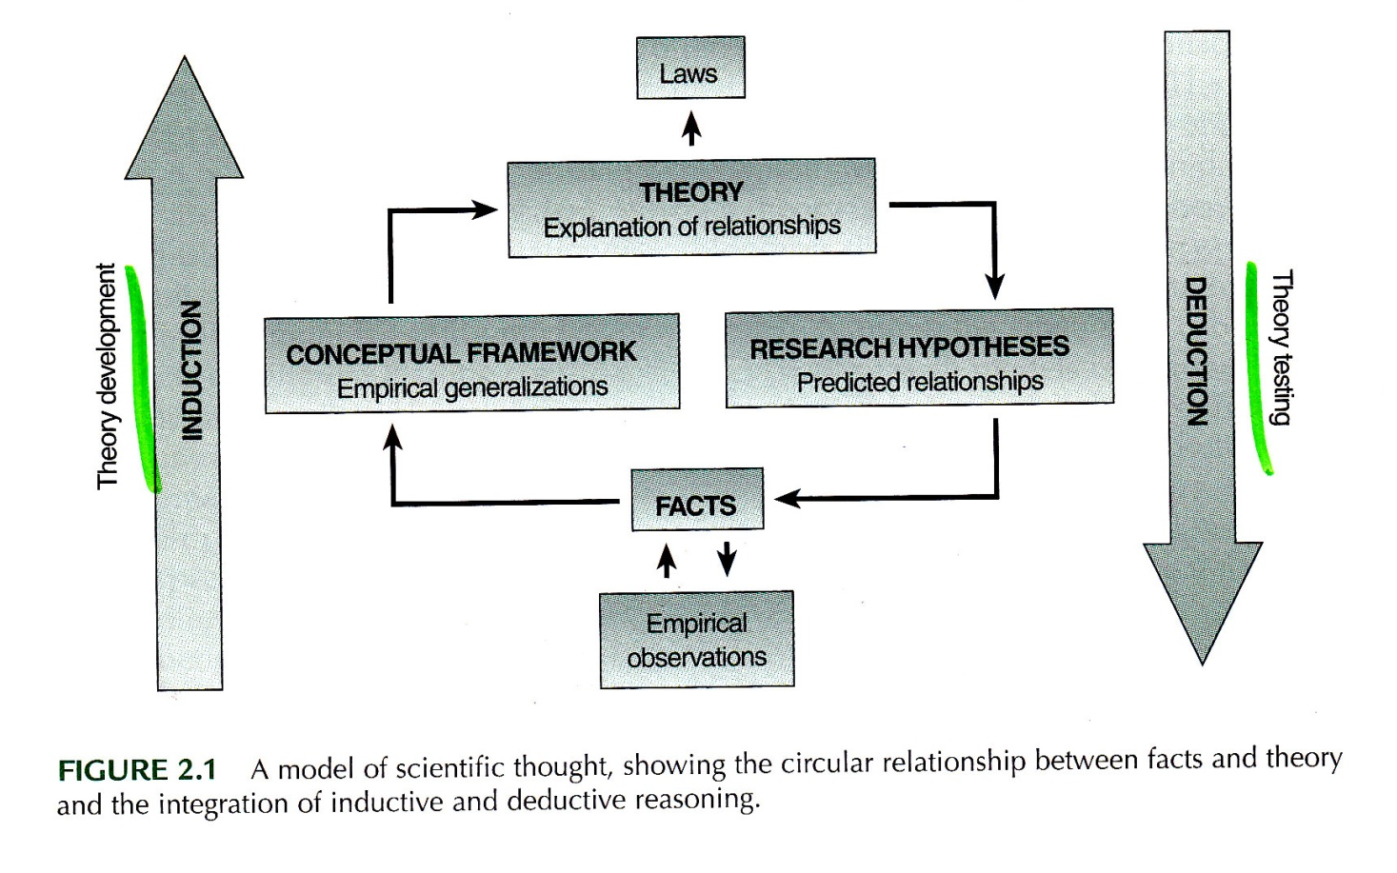
Clinical Research Introduction
Portney & Watkins (2009)
10
Notes:
[

Slide 11
Assignment
11
Blackboard –
Review syllabus
Complete syllabus quiz
Read Chapter 1
Discussion Forum
Prepare for Week 2

